Slide 1

Machine Maintenance Analysis
Group 3
Peter Hara
Adelle Housker
Rami Ibrahimi
Sean Patel
Laith Yousif

Slide 2
Executive Summary
Overview
Group 3 analyzed a synthetic dataset for detecting patterns regarding certain machine failures. Six features and two targets were provided – one target was a binary for failure/no failure, while another was a multivariate variable that included six failure types
Risks
One concern about the dataset was that ~97% of the Failure Types were “No Failure”, indicating a very imbalanced dataset; The team addressed this by comparing the accuracy scores from the as-is data versus oversampled and undersampled versions
Null Hypothesis
The team’s initial hypothesis was that the feature “Tool Wear” would have the biggest impact on likelihood of machine failure, but that there would be particular features that would contribute more regularly to each of the six different failure types
Approach
Data Overview
Analyses
Conclusions & Next Steps

Slide 3
1) Data Overview
Synthetic Data
10,000 rows x 10 columns
Features
IDs
Type: Consisting of a letter L, M, or H for Low, Medium, or High
Air temperature [K]: Generated using a random walk process later normalized to a standard deviation of 2 K around 300 K
Process temperature [K]: Generated using a random walk process normalized to a standard deviation of 1 K, added to the air temperature plus 10 K
Rotational speed [rpm]: Calculated from power of 2860 W, overlaid with a normally distributed noise
Torque [Nm]: Torque values are normally distributed around 40 Nm with an Ïƒ = 10 Nm and no negative values
Tool wear [min]: The quality variants H/M/L add 5/3/2 minutes of tool wear to the used tool in the process and a 'machine failure' label that indicates whether the machine has failed in this particular data point for any of the indicated failure modes
UID: Unique identifier ranging from 1 to 10,000
ProductID: Consisting of a letter L, M, or H for Low (50% of all products), Medium (30%), or High (20%) as product quality variants and a variant-specific serial number
Targets
Target: 0 (No Failure) or 1 (Failure)
Failure Type: Heat Dissipation Failure, Overstrain Failure, No Failure, Power Failure, Random Failures, Tool Wear Failure
Source: https://www.kaggle.com/datasets/shivamb/
machine-predictive-maintenance-classification

Slide 4

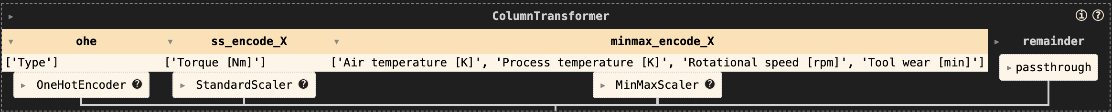

2) Analyses
Dropped ID columns (e.g., UID, ProductID)
Converted feature "Failure Type" into 5 dummy variables
Split data into training and test sets
Scaled data in the feature columns using StandardScaler and MinMaxScaler
Used one-hot encoding for feature "Type" (e.g., L, M, H)
Data Cleaning & Manipulation
Data Preprocessor (Scaler, Dummy, OHE)
Data Sampler (Over/Under) - intended
Models
9 supervised learning regression / classification models
Grid search to optimize search
Pipeline

Slide 5
2) Analyses – Model Accuracy Scores
Model | As-Is Dataset | Oversampled Data | Undersampled Data
Logistic Regression | 0.79 | 0.61 | 0.60
K-Nearest Neighbors | 0.83 | 0.95 | 0.77
Decision Tree | 0.90 | 0.94 | 0.78
Random Forest | 0.89 | 0.96 | 0.83
Extremely Random Trees | 0.88 | 0.97 | 0.80
Gradient Boosting | 0.88 | 0.86 | 0.83
AdaBoost | 0.87 | 0.84 | 0.80
Support Vector Machine | 0.86 | 0.80 | 0.82
Naïve Bayes | 0.80 | 0.75 | 0.77

Slide 6
2) Analyses – Model Accuracy Scores
Model | As-Is Dataset
Logistic Regression | 0.79
K-Nearest Neighbors | 0.83
Decision Tree | 0.90
Random Forest | 0.89
Extremely Random Trees | 0.88
Gradient Boosting | 0.88
AdaBoost | 0.87
Support Vector Machine | 0.86
Naïve Bayes | 0.80

Slide 7
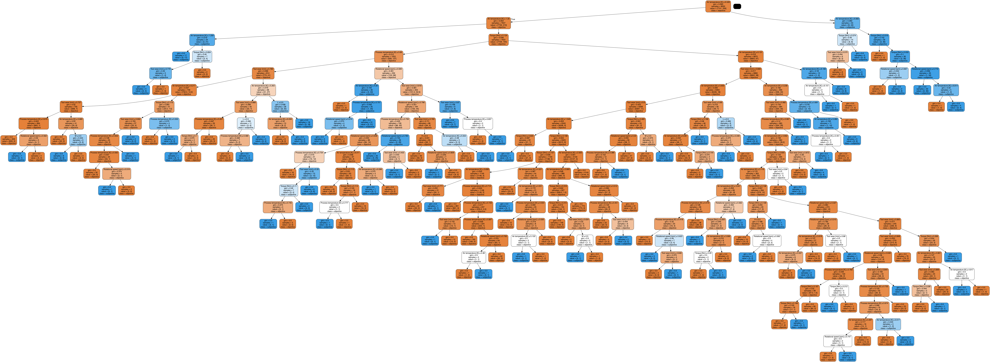
2) Analyses – Decision Tree

Slide 8
2) Analyses – Feature Contribution
Feature | Weight
Torque [Nm] | 0.320955
Rotational speed [rpm] | 0.214712
Air temperature [K] | 0.161565
Tool wear [min] | 0.153936
Process temperature [K] | 0.148831
Feature | P-Values
Torque [Nm] | 1.488773e⁻¹⁰²
Rotational speed [rpm] | 2.432644e⁻⁸³
Tool wear [min] | 1.856158e⁻²⁶
Air temperature [K] | 1.361908e⁻¹⁹
Process temperature [K] | 3.944958e⁻¹¹
Feature Importance
Feature P-Values
Component 1 | Weights
Torque [Nm] | -0.996
Rotational speed [rpm] | 0.092
Type = L | -0.008
Type = M | 0.007
Air temperature [K] | 0.003
Component 2 | Weights
Type = L | -0.743
Type = M | 0.664
Type = H | 0.079
Torque [Nm] | 0.011
Tool wear [min] | -0.004
PCA Analysis

Slide 9
3) Conclusions & Next Steps
Contrary to our initial null hypothesis, Torque was the leading cause of machine failure according to our models
Undersampling the data negatively impacted the accuracy scores compared to the raw as-is dataset, as expected, but the oversampled data actually performed better surprisingly
So the next step would be developing an algorithm that only states “No Failure” will be accurate 96.5% of the time and performs better than any of our models or ChatGPT! So instead of all this we could have written the below code and saved the environment from all these machine learning processes…
def predict_failure(df):
return False

Slide 10
3) Conclusions & Next Steps
Contrary to our initial null hypothesis, Torque was the leading cause of machine failure according to our models
Conducting an analysis on Oversampling vs Undersampling would help determine how good each model truly is, because…
…developing an algorithm that only states “No Failure” will be accurate 96.5% of the time and performs better than any of our models or ChatGPT! So instead of all this we could have written the below code and saved the environment from all these machine learning processes…
def predict_failure(df):
return False

Slide 11
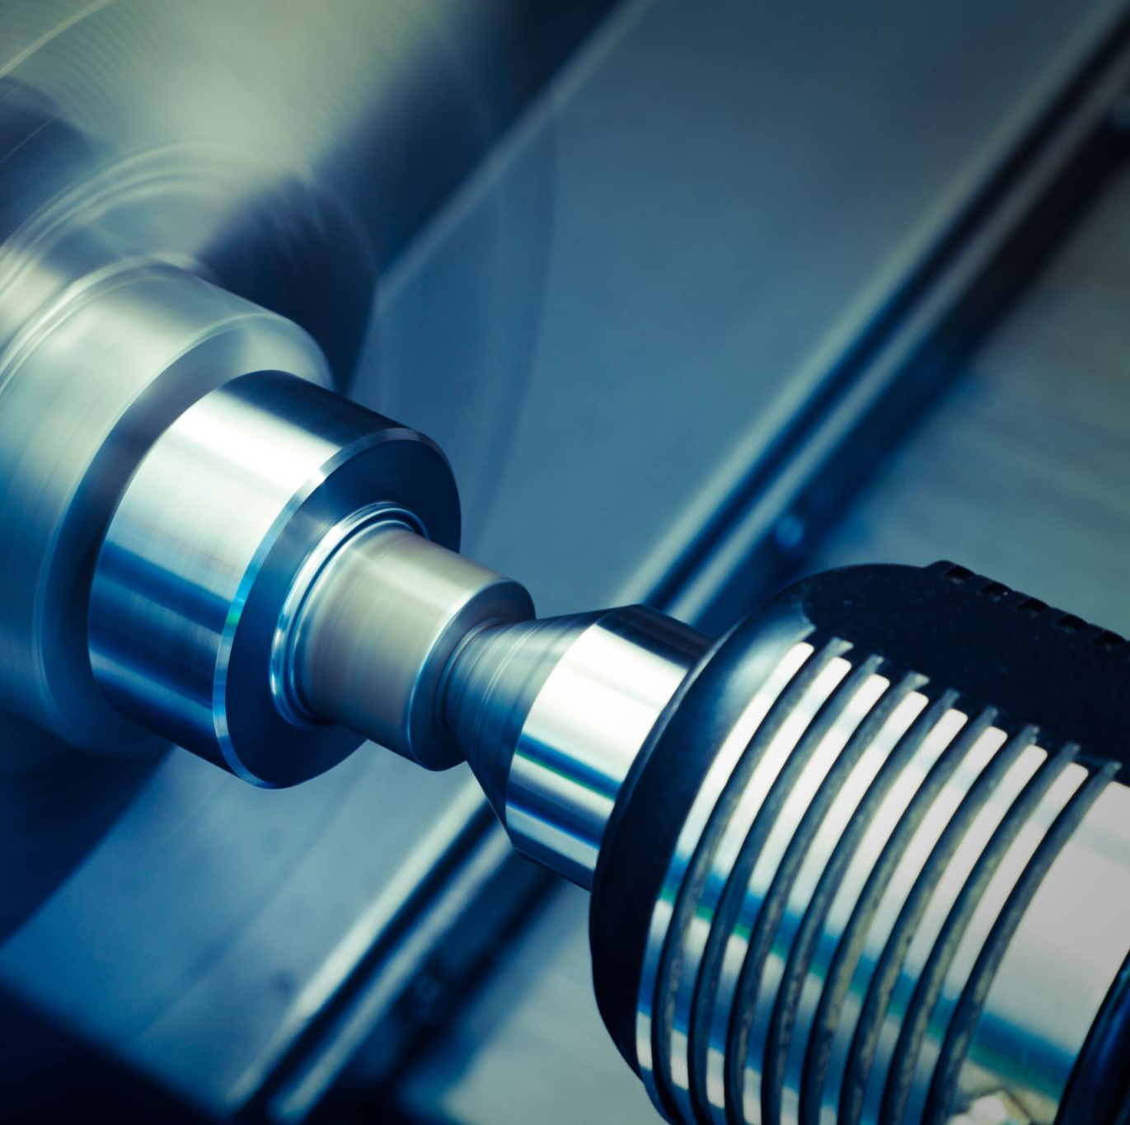
Fin
Reach out to Group 3 with any machine maintenance needs…
Thank you!!

